Slide 1
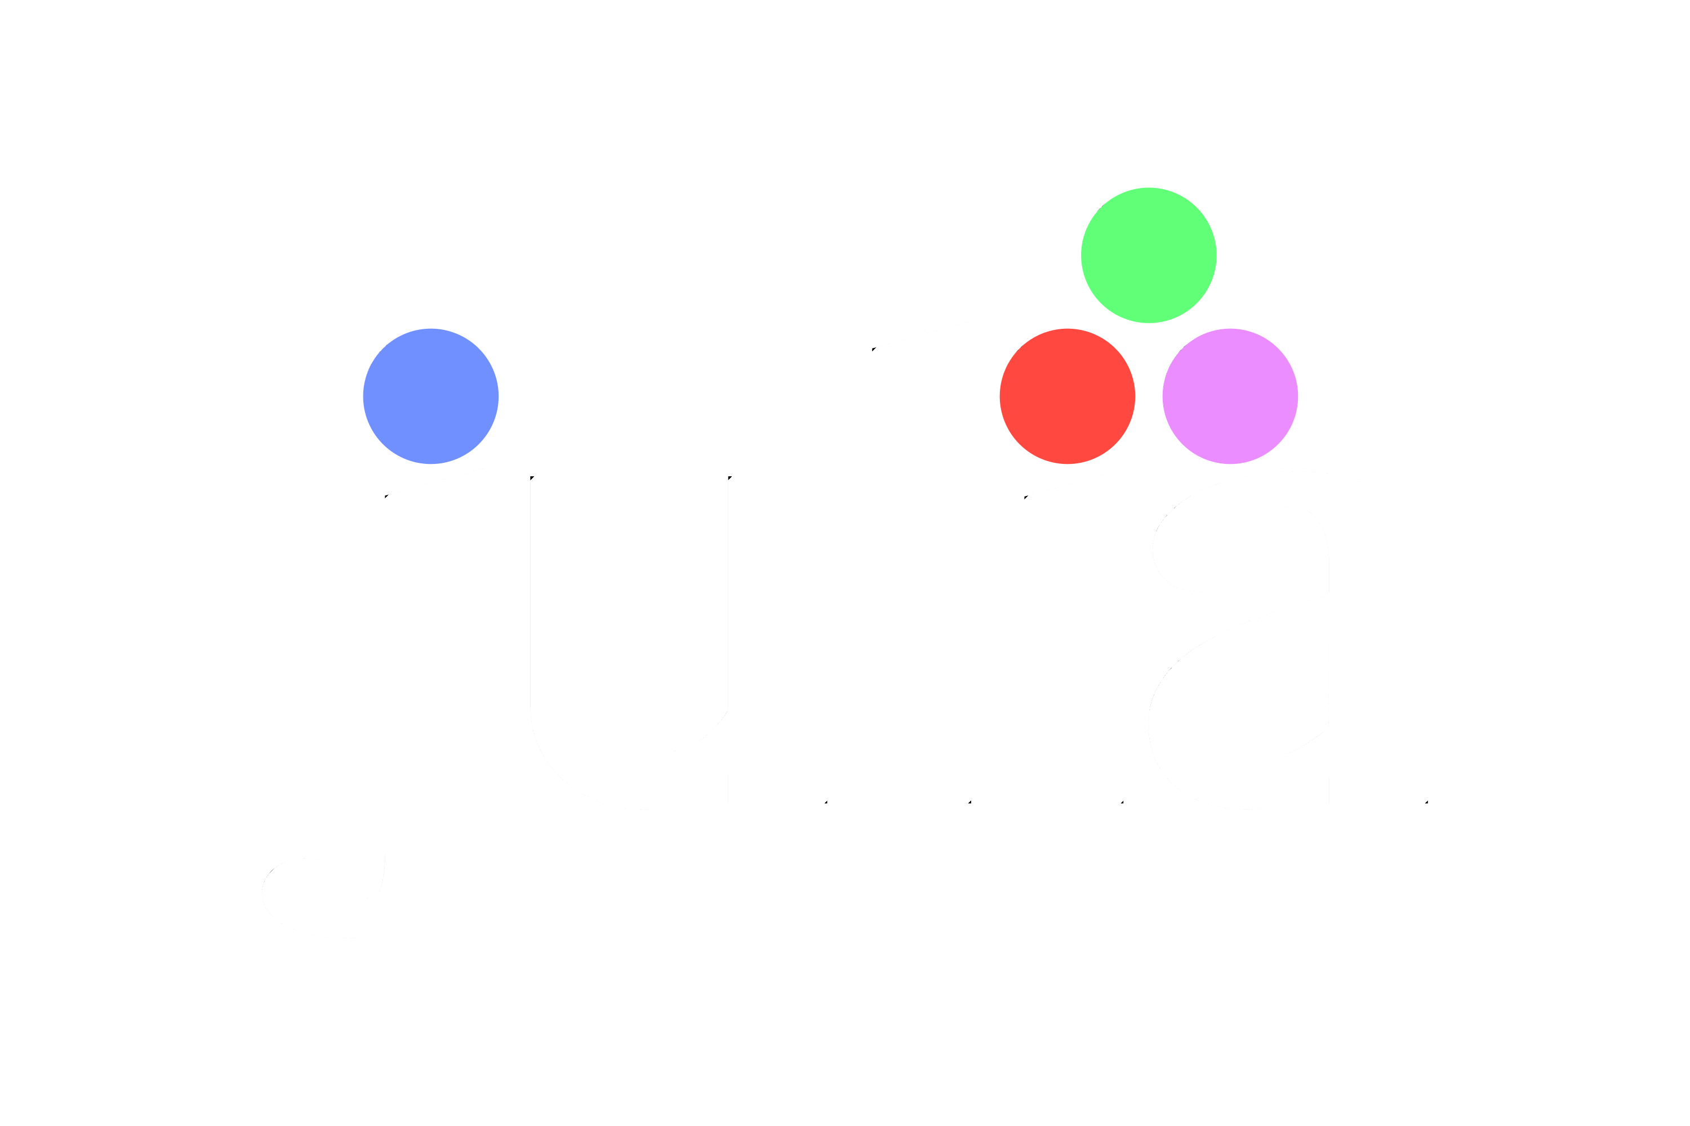
For Beginners!
© Copyright Matthew Flood, 2022
Notes:
Check that everyone has installed Plots.jl

Slide 2
For Beginners!
Week 3:
For loops, While loops, and the Bang(!) operator
Conditional (if-else) statements
Try-catch statements
User input

Slide 3
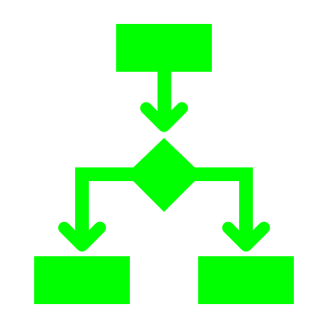
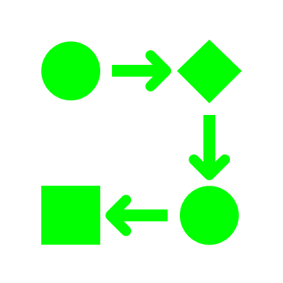
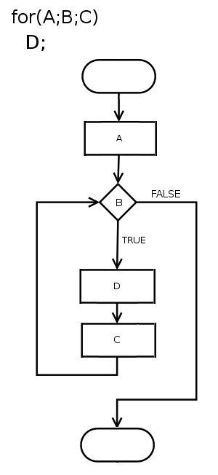
What control flow?
The term ‘control flow’ relates to the way the series of operations/instructions/tasks are executed.
Loops are ways to control how many times a task is performed,
e.g. update/edit every item in an array or dictionary
Conditional statements control how decisions are made during code execution,
i.e. Start/stop operations, go/no-go decisions.

Slide 4
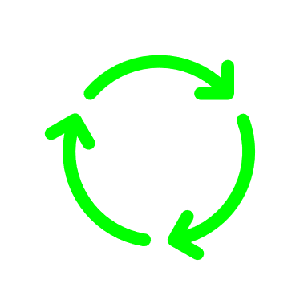


What are loops?
Loops are a type of method that allows us to repeatedly perform a series of tasks efficiently.
Loops repeat the series of tasks until a condition is met, at which point the repetition stops.
**NB: the loop won’t stop until it reaches a point where it is told to.
As some loops can (in theory) forever, we can break the loop execution using the special keyword ‘break’
The 2 types of loops we’ll use are
For loops
While loops

Slide 5
Writing Loops
All loops are written in blocks.
This means that they begin with a statement and end with the ‘end’ keyword.
Statement …
task 1 goes here
task 2 here
and so on
…
…
until
end

Slide 6
For Loops
For loops are used to iterate over a range of values.
In our initial statement, we must assign a variable to represent each value in the iterated range.
For loops in Julia have the following form:
The variable called ‘var_name’ will take on every value from 1 to 100
In this example, the range includes every value from 1 to 100
for var_name = 1:100
do_something = function(var_name)
do_something2 = function(do_something)
…
end
The block begins with the word ‘for’
The block ends with the word ‘end’

Slide 7
For Loops
The iterated variable does not have to be numeric.
For example, we could iterate through every key in a dictionary (last week’s class) and perform operations on the values for each key
E.g.
Phonebook = Dict(“John” => “1553418392”, “Mary” => “1568899103”,
“David” => “1678889990”, “Jane” => “1579009009”, … )
for Name = keys(Phonebook)
Phonebook[Name] = “+352” * Phonebook[Name][2:end]
end
In this example we:
Create a dictionary to store our friends phone numbers (**as strings**)
Start the for loop block with ‘for’
Create a variable called ‘Name’ which takes on the key of each dictionary entry
Update each phone number (dictionary value) by adding an international dialling code and removing the ‘1’ at the start of each number, i.e. [2:end]
Close the block with ‘end’

Slide 8
While Loops
Whereas for loops go through each value in a range, while loops continue indefinitely until a stopping condition is met.
Instead of an iterated variable, while loops have a conditional variable that must be declared before the loop starts
While loops have the following form:
The conditional variable called ‘var_name’ is declared before the while loop with value = 1
In this example, the while loop will continually execute the tasks in the body of the block unless the value of x becomes greater than 99
var_name = 1
while var_name < 100
do_something = function(…)
var_name = function(do_something)
end
The block begins with the word ‘while’
The block ends with the word ‘end’
The value of the conditional variable is updated in each iteration of the loop.

Slide 9


While Loops
WARNING:
If the conditional statement is never met, the while loop will run indefinitely! If gone unnoticed, this could use up huge computer resources and may even lead your system to crash… (so be careful people!)

Slide 10
The Bang(!) operator
In the previous example, we changed the value of the variable var_name in each iteration of the loop. If we didn’t, the stopping condition would never have been met as var_name (value = 1) would always be < 100.
Updating or manipulating the values assigned to variables happens all the time when programming, but it can be hard to find where it happens in your (or someone else’s code).
To make it changes to variables ‘on the spot’, we can use the Bang(!) operator.
Notes:
Reference Python and my name.

Slide 11
The Bang(!) operator
For example, say you have an array called Results which contains measurements from an experiment, but you want them sorted from smallest to largest. Normally we would write:
Results = sort(Results)
This is perfectly fine to write, but because the input and the output are the same variable (Results), it can be hard to spot errors in your code if there is a problem with Results.
So instead, Julia gives us the Bang(!) operator to modify variable values on the spot without writing it in the form above.
E.g.
sort!(Results)
NOTE: The bang operator is only possible with some functions, not all, such as sort!(), pop!(), push!(), append!()
NOTE: The bang operator on its own !() is a different function
Notes:
Reference Python and my name.

Slide 12
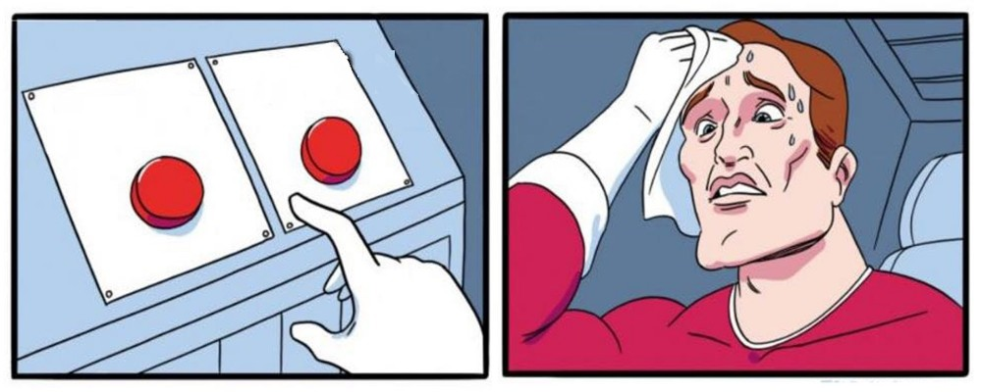
Conditional Statements
We saw conditional statements previously when declaring while loops.
Here we look at if-else conditional statements which are used to answer yes/no questions, make decisions or perform checks on your code.
So they’re kinda important to put it mildly…
Like loops, if-else statements are declared in blocks that start with a statement, have a body of operations and end with ‘end’.

Slide 13
if-else Statements
Conditional statements that are either true or false.
Start with ‘if’
if cond_statement1
# do these tasks if cond_statement1 is true
elseif cond_statement2
# do these tasks if cond_statement1 is false
# but cond_statement2 is true
elseif cond_statement3
# do these tasks if cond_statement1 & cond_statement2
# are false but cond_statement3 is true
else
# do these tasks if all above cond_statements are false
end
If you are comparing 3 or more conditions, include ‘elseif’ keywords.
Otherwise just use ‘if’ and ‘else’.
End with ‘end’

Slide 14
if-else Statements
Example:
Countries = (“Luxembourg”, “Brazil”, “Turkey”, “Jamaica”, “Ireland”)
if “Sweden” in Countries
print(“They speak Swedish in Sweden.”)
elseif “Ireland” in Countries
print(“They speak Gaeilge in Ireland.”)
elseif “Turkey” in Countries
print(“They speak Turkish in Turkey.”)
else
print(“I don’t know what language they speak…”)
end
This will be false
This will be true
This will be true, but not executed
This will only be executed if ‘Countries’ doesn’t contain Sweden, Ireland or Turkey
Notes:
Ask class what they think will happen in each level of the loop.

Slide 15
if-else Statements
If we’re only checking one condition, we can write our if-else statement more simply.
Countries = (“Rwanda”, “Brazil”, “Turkey”, “Jamaica”, “Ireland”)
“Rwanda” in Countries ? print(“Rwanda is a country.”) : print(“Not a country”)
is a neater way of writing:
if “Rwanda” in Countries
print(“Rwanda is a country.”)
else
print(“Not a country”)
end
The ‘if’ part follows the ? The ‘else’ part follows the :
Notes:
Ask class what they think will happen in each level of the loop.

Slide 16
try-catch Statements
If we’re unsure if our conditional statement will be neither true or false, but instead it might throw an error, we can use try-catch statements.
Try-catch statements are used for handling errors.
First we try to see if a statement is true.
If we get an error, we catch it instead of our program execution cancelling
The block begins with the word ‘try’
try cond_statement
# do this if cond_statement true
catch
# do this if an error occurs
end
The block also has the word ‘catch’
The block ends with the word ‘end’
Notes:
Ask class what they think will happen in each level of the loop.

Slide 17
try-catch Statements
Example: We have a variable, X, but we don’t know if it is a number type (Float or Int) or a string type. However, we need it to be a number type in order to do mathematical operations with it (remember, you can’t do maths with a string of text!)
X = “49”
try sqrt_X = sqrt(X)
Y = sqrt_X + 3
catch
print(“Check that X is a number type”)
end
# X is a string
# try to calculate the square root of X
If we were to try the above code with an if-else statement, we would receive an error when attempting to execute sqrt(X) and the program will stop.
With the try-catch statement, the program will continue to run despite the error.
Notes:
Ask class what they think will happen in each level of the loop.

Slide 18
User Input
The mismatched data type problem used in the previous example is likely to arise when we take in user input.
In Julia, user input is done using the function, readline().
readline() accepts input in string format, so we have to use the parse() to convert it to a number format.
Example:
println(“What is your name?”)
Name = readline()
Julia> What is your name?
Adele
println(“Your name is $Name”)
Julia> Your name is Adele
println(“What is your age?”)
Age = readline()
Julia> What is your age? 55
AgeNumber = parse(Int64, Age)
Months = AgeNumber*12
println(“You are ”*string(Months)*“ months old”)
Julia> You are 660 months old
Notes:
Age is read in as a string

Slide 19
Like learning a real language, the only way to become fluent is to practice.
OK, let’s start writing some code!!!

Slide 20
For Beginners!
Homework Week 3:
Complete exercise sheet for week 3.

